Slide 1


Clinical case studies
Applications of Vaginal cytology evaluation
By: Asghar Mogheiseh
School of Veterinary Medicine, Shiraz University

Slide 2
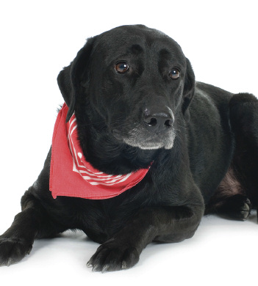
Vulvar Discharge in the Bitch
Ap p l i e d Cy t o l o g y: T H E R I O G E N O L O G Y
NAVC Clinician’s Brief / January 2012 / Applied Cytology
Case 1: An 11-year-old Labrador retriever bitch that had been ovariohysterectomized 8 years earlier had become attractive to male dogs for about 3 months. According to the owners, the dog also had continually exhibited a pale red, copious vulvar discharge.
Pertinent examination findings included a moderately enlarged vulva (Figure 1A) with serosanguineous,
malodorous discharge. Vaginal cytology (Figure 1B) revealed parabasal cells, intermediate cells, and numerous neutrophils, along with rare erythrocytes.

Slide 3
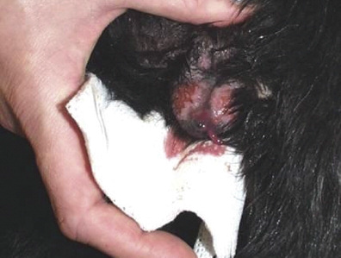
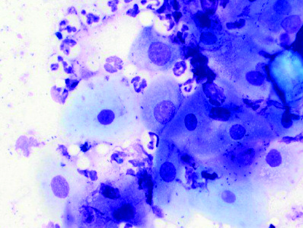

Slide 4
Continue case 1
On abdominal ultrasonography, a 15 × 18–mm cystic mass was noted caudolateral to the right kidney (Figure 1C). A second mass (Figure 1D) located dorsal to the urinary bladder and measuring 4.39 . 2.72 cm high (sagittal view) was filled with flocculent fluid. Escherichia coli organisms were isolated on aerobic culture of the vagina.

Slide 5
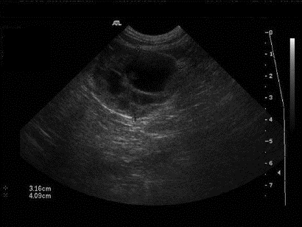
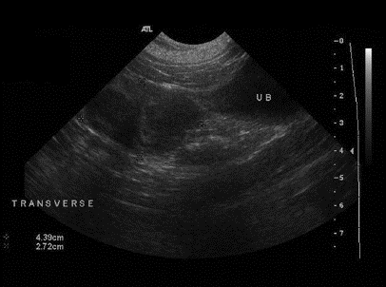

Slide 6
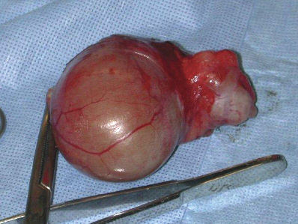
Continue case 1
The perinephric mass and the uterine stump were removed via laparotomy (Figures 1E, 1F, and 1G). Histopathology identified a luteoma originating from a right ovarian remnant as well as uterine stump pyometra with endometrial progesterone influence. Progesterone assay indicated a level of 9.2 ng/mL (normal >2 ng/mL), which is compatible with functional corpora lutea.

Slide 7
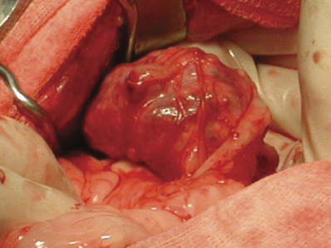
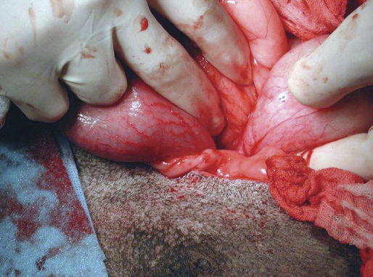

Slide 8
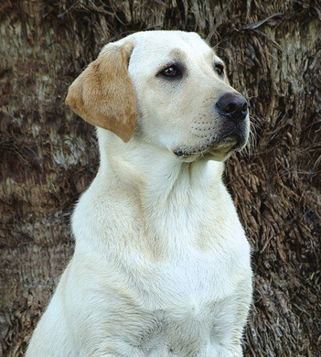
Case 2: Foreign Body Bacterial Vaginitis
A 3-year-old Labrador retriever bitch was ovariohysterectomized at 6 months of age. The owners reported that she had been licking her vulva excessively for 3 days and now had pink spotting on her bedding.
Pertinent examination findings included evidence of pain on digital palpation of the vulva and vulvar excoriations. A small amount of purulent discharge was noted (Figure 2A). Vaginal cytology (Figure 2B) revealed moderate numbers of parabasal cells and numerous neutrophils.

Slide 9
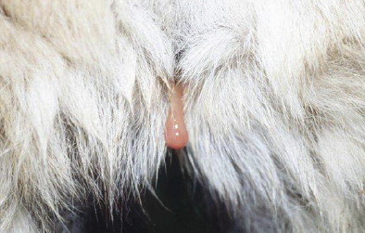
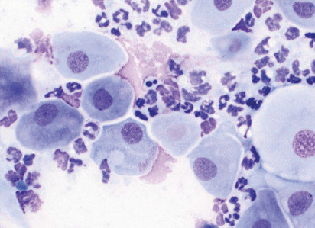

Slide 10
Vaginal cytology from a dog with vaginitis (Wright’s stain, 400×).

Slide 11
Continue case 2
Abdominal ultrasonography showed a hyperechoic linear object within the uterine stump, dorsal to the urinary bladder (Figure 2C). Examination findings and vaginal cytology failed to support hormonal influence (no vulvar swelling or cornification). Vaginoscopy (Figure 2D) exposed a foxtail (grass awn) embedded in the vaginal os of the cervix. It was removed with retrieval forceps under endoscopic guidance.

Slide 12
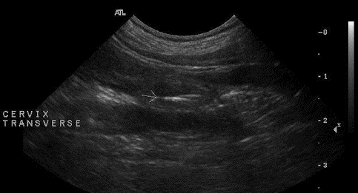
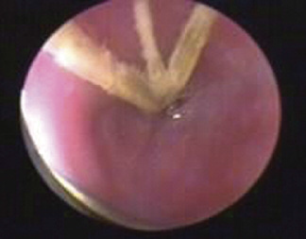

Slide 13
Case 3: Vulvar Discharge in a Puppy
An apparently healthy Labrador retriever puppy presented with a mucoid vulvar discharge.
History
The owners reported that the patient, an intact female 8 weeks of age, was mostly housebroken, but they were uncertain if her urinary behaviors were abnormal, as the puppy would urinate outdoors and then again in the house. The patient had been acquired a week previously and had received a single DA2PP vaccination; she received no medications.
Physical Examination
The puppy appeared normal at presentation (101.2°F, heart rate 130 bpm, panting respiratory rate). Tan mucoid vulvar discharge and some matted fur were evident in the perivulvar area. Perivulvar dermatitis was not apparent (Figure 1). Urination was observed and appeared normal. There was no evidence of pollakiuria, dysuria, stranguria, or gross hematuria.

Slide 14
Laboratory Diagnostics
Urine (obtained via cystocentesis) was submitted for urinalysis and urine culture pending evidence of cystitis on sediment examination. Urine-specific gravity was 1.023, urine sediment was benign, and culture was not indicated nor submitted. Cytology of the vulvar discharge was suppurative, revealing numerous nondegenerate neutrophils (Figure 2).

Slide 15
Important differentials to rule out for purulent vulvar discharge:
n Bacterial cystourethritis, which can result in pyelonephritis if not recognized and treated effectively
n Vulvovaginal foreign body (eg, grass awn; Figure 3)
n Urine pooling and perivulvar dermatitis resulting from anatomic problems, especially urinary incontinence secondary to an ectopic ureter, excessive vulvar hooding (Figure 4), or disorders of sexual differentiation (uncommon) causing clitoral hyperplasia (Figure 5)
o Vestibulovaginal strictures, which, if present, are usually not contributory, as they are cranial to the urethral papilla and do not cause urine pooling.

Slide 16

Case 43: Estrogen Exposure
A 5-year-old pug that had been ovariohysterectomized at 7 months of age was presented when the owner noted vulvar enlargement and spotting. In addition, while at the park the pug had become attractive to male dogs during the past 6 weeks. Pertinent physical findings included vulvar enlargement (Figure 3A) and flagging (receptive behavior). Scant hemorrhagic vulvar discharge was also evident.
Vaginal cytology revealed greater than 90% superficial epithelial cells (Figure 3B), a finding compatible with estrogen influence. The presence of red blood cells and bacteria can be variable during estrus, while the absence of neutrophils suggests the bacteria are opportunistic, not pathogenic.

Slide 17
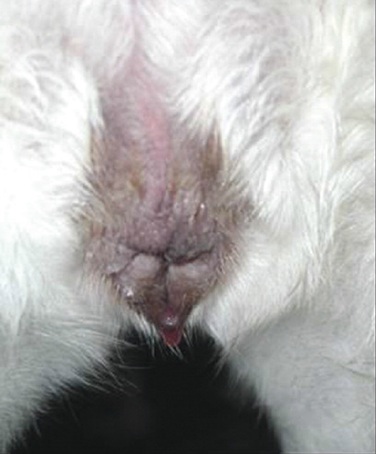
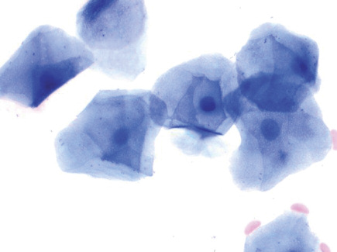

Slide 18
Continue case 4
Abdominal ultrasonography (Figure 3C) showed a prominent but homogenous uterine stump; scant fluid was evident in the uterine stump lumen. There was no evidence of ovarian structures in the region caudolateral to the kidneys.
When specifically questioned, the owner indicated that the housekeeper recently began using transdermal hormone replacement therapy on the forearms and frequently held the pug in her arms. Clinical signs abated over a period of weeks after contact with the dog had been discontinued.

Slide 19
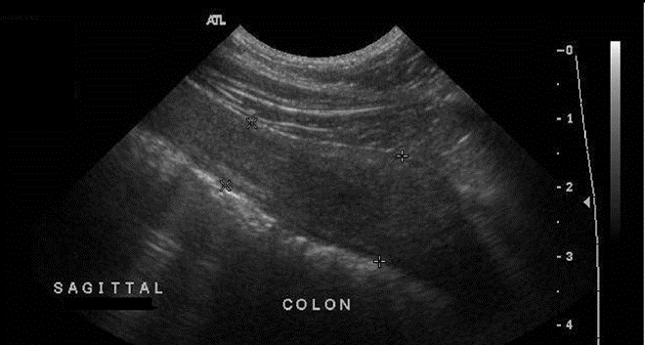

Slide 20
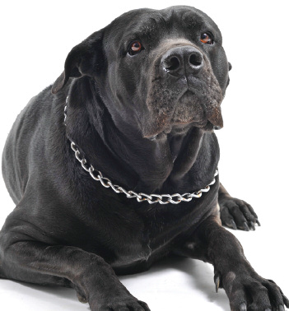
Case 5: Uterine Fluid Loss During Pregnancy
A 3-year-old multiparous Cane Corso bitch presented at term gestation after delivering 2 nonviable fetuses. Physical findings included marked abdominal distention, intermittent tenesmus, and malodorous black–green vulvar discharge. No fetus was palpable in the vagina. Brucella canis slide agglutination was negative; subsequent vaginal culture grew Proteus mirabilis organisms.
Cytology of the vulvar discharge (Figure 4A) revealed purulent discharge with numerous toxic neutrophils, intra- and extracellular bacteria, and parabasal vaginal mucosal cells.

Slide 21
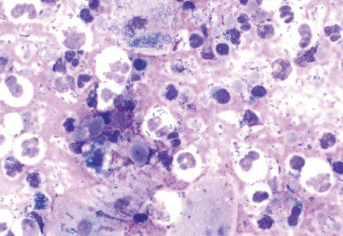

Slide 22
Continue case 5
No cardiac motion was detected on abdominal ultrasonography of 7 nonviable fetuses (Figure 4B). Cardiac motion (Figure 4C) was shown on Doppler imaging of a viable fetus.
Tocodynamometry (uterine monitoring) showed a hypotonic myometrium; no effective uterine contractions were present before or following 10% calcium gluconate and oxytocin administration (Figure 4D).

Slide 23
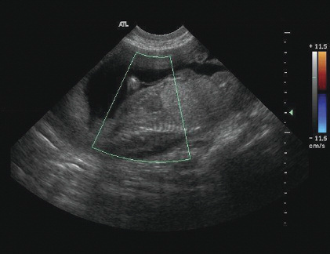
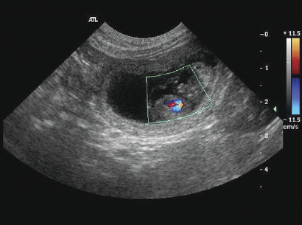
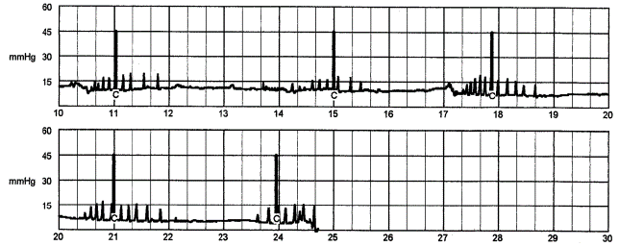

Slide 24
Continue case 5
The nonviable fetuses were removed via hysterotomy. According to the surgeon, less than a normal amount of fluid was present in the uterus surrounding the fetal amniotic sacs. The uterus otherwise appeared normal; it was lavaged and preserved, as this dog was a valuable breeding bitch.

Slide 25
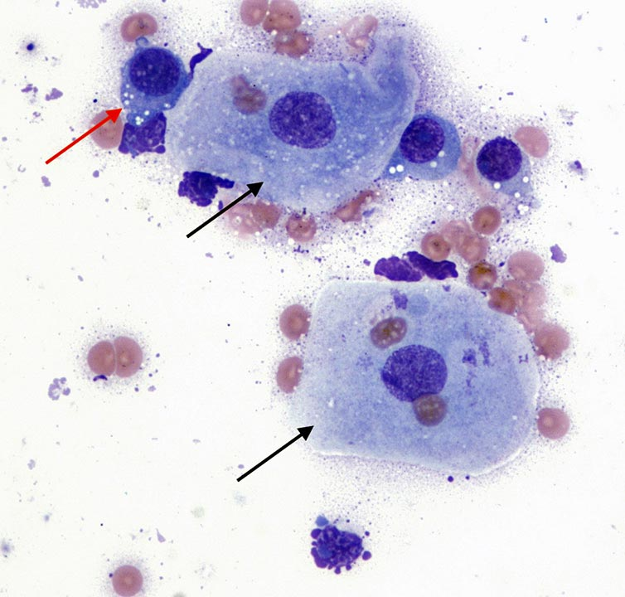
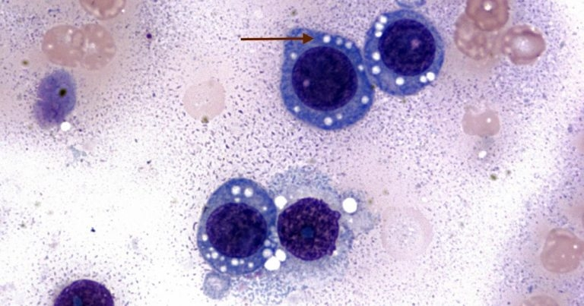
Case 6: Study of a young dog with haemorrhagic vaginal discharge
These two microscopic images (Wright-Giemsa stain 100× [Figure 1] to 50× [Figure 2]) are from a vaginal swab of a 1.5-year-old female crossbreed dog imported from eastern Europe. The dog had apparently been neutered and the vet suspects an ovarian remnant syndrome as a cause of the vaginal discharge.
The submitted smear is moderately cellular with adequate preservation.
The background is lightly basophilic with moderate numbers of red blood cell.
A main population of discrete, round cells exists, together with a few superficial vaginal squamous epithelial cells (black arrows) and rare neutrophils.

Slide 26






Slide 27
Case 7: Ovarian remnant syndrome (ORS)
Clinical Theriogenology 2022; 14: 370
Ovarian remnant syndrome in small animals: case series
History
Clinical signs
Estrous signs: vaginal secretions
Vaginal cytology

Slide 30
CASE 6: A 10-year-old entire female Boxer presented with a history of persistent estrus and a hemorrhagic vulvar discharge. Abdominal ultrasound revealed a 7 cm left ovarian solid mass. An FNA from the ovarian mass was collected. Smears of the aspirate are shown (15a–c; Diff-Quik®, ×20, ×40, and ×10, respectively).

Slide 31


Slide 32
